Slide 1
Artificial Light - Harvesting Arrays Based on Photonic Crystals
Molecular Photonics Laboratory, School of Chemistry, Bedson Building, Newcastle University, Newcastle Upon Tyne, NE1 7RU
ROZA ABDULRAZAQ SALIH
23/03/2016

Slide 2
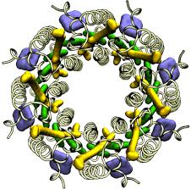
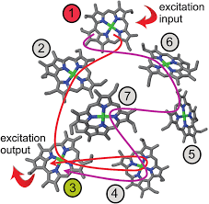
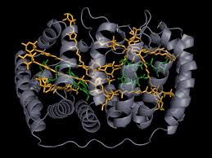
Introduction
Natural photosynthetic organisms employ light-harvesting antennae to collect sunlight over a wide spatial region and direct the resultant molecular-based excitons to a site where fuel formation takes place. The light-harvesting machinery is extremely well organised, compact and adaptable. It serves many important purposes, including light regulation, and can accommodate highly variable light fluxes without damage.
The most intriguing feature of the natural photosystems is their capacity for self-repair under intense sunlight. Although some of these features have been duplicated with artificial analogues, most notably the efficient electronic energy-transfer (EET) steps that move an exciton around the network, our model systems are too small and still at a primitive stage.

Slide 3
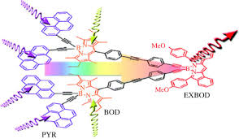
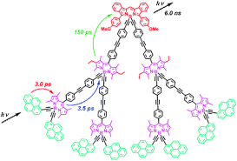
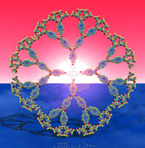
However, if we are to build an effective molecular system for solar fuel formation it is essential that improved artificial photon concentrators are identified quickly. A major stumbling block for the design of viable light-harvesting arrays is the need to position chromophores in close proximity without introducing problems from self-absorption or self-quenching.
To ensure a large collection area while minimising the density of catalytic sites, it seems necessary to provide for multiple EET steps to direct the exciton to a particular residue. Given that the EET steps between identical molecules will occur via a random walk, this requires the cooperation of hundreds, if not thousands, of individual chromophores.
A promising but unexplored way to achieve this level of organisation is to make use of photonic crystals.

Slide 4
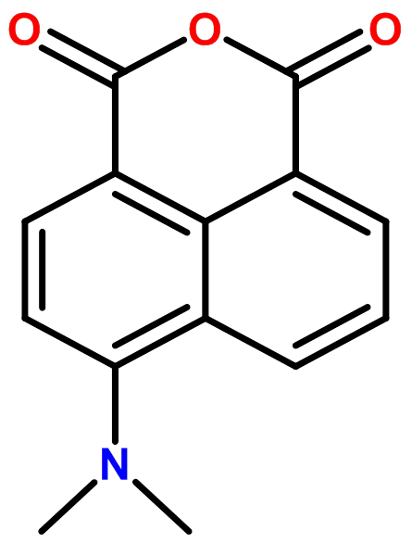
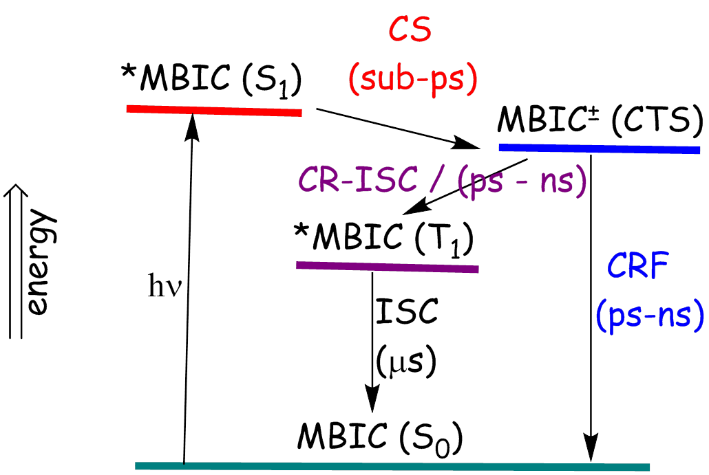
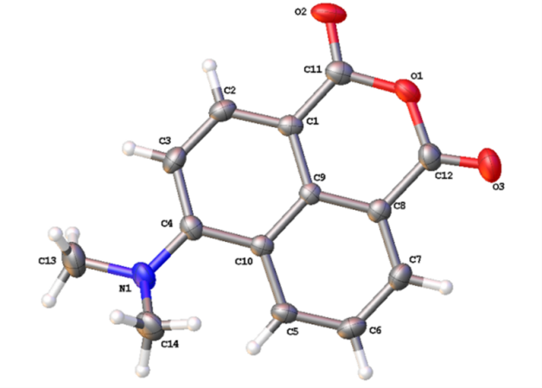
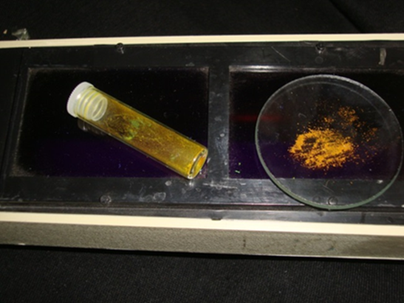
6-(dimethylamino)-1H,3H-benzo[de]isochromene-1,3-dione (MBIC)
MBIC crystal structure and solid-state fluorescence

Slide 5
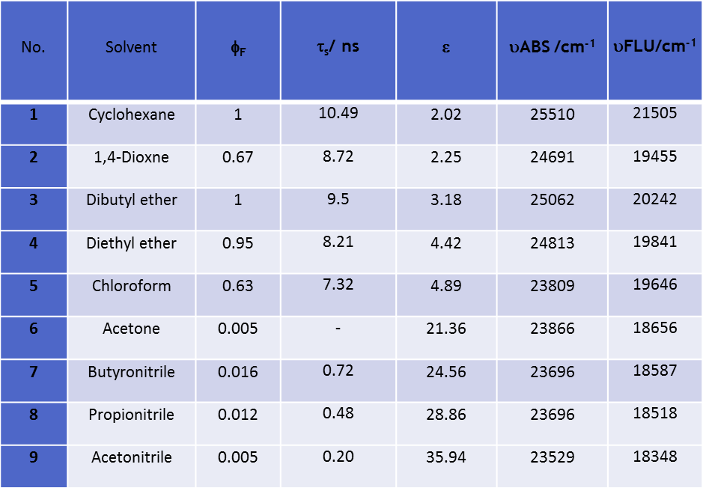
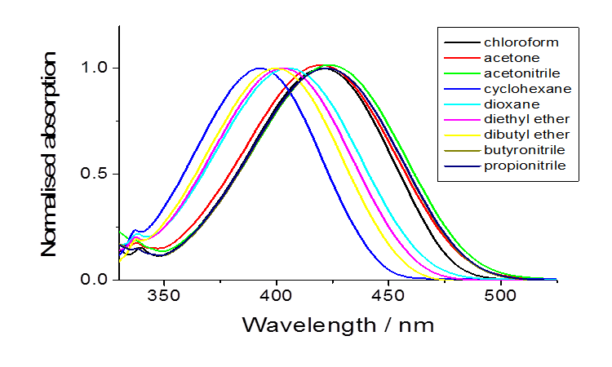
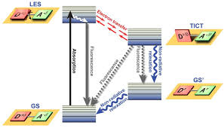
Normalised absorption spectra for MBIC in solvents of differing polarity at room temperature. The band shape
does not change but the position depends on the
dielectric constant.
Photophysical properties recorded for MBIC in selected solvents (out of a total of 25) at room temperature
The photophysical behavior of a dissolved dye depends on the nature of its environment; i.e. the intensity, shape, and maximum wavelength of the absorption band of the dye in solution depends strongly on the solvent-solute interactions and the nature of the solvent.

Slide 6
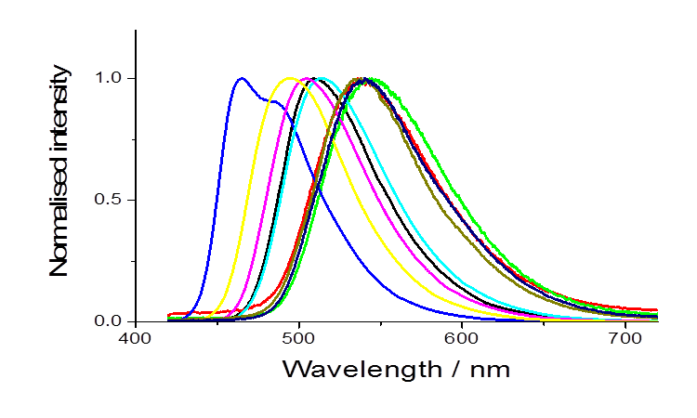
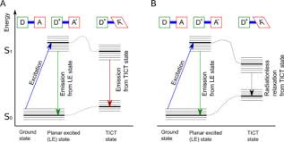
Solvent polarity and the nature of the local environment can have profound effects on the emission spectral properties of polar fluorophores.
Fluorescence quantum yields and excited-state lifetimes, which might depend on polarity, viscosity, temperature, pressure, availability of protons, hydrogen bonding and specific solvent effects.
It is sometimes possible to detect emission from vapours or from single crystals. The latter have important applications in opto-electronics and photonics. As an extension to our work, we have studied charge-recombination fluorescence in a crystal.
Normalised fluorescence spectra for MBIC in the same solvents

